Slide 1

GEO3460 – Landmåling, fotogrammetri og romlig analyse – vår 2024
GEO3460 - Surveying, photogrammetry and spatial analysis - spring 2024
Interpolation
Martin Lund (e.m.lund@geo.uio.no)
Based on the lectures by Dr. Livia Piermattei

Slide 2

Reference text book:
“Geographical information systems” (not available online)
Chapter 8

Slide 3

Learning Objectives
1
2
3
GIS interpolation
What?
When?
Data sources for interpolation
Spatial Interpolation Methods
Interpolation algorithms
Interpolation examples and application
Today’s topics

Slide 4
Learning Objectives
1
2
3
GIS interpolation
What?
When?
Data sources for interpolation
Spatial Interpolation Methods
Interpolation algorithms
Interpolation examples and application
Today’s topics

Slide 5
Interpolation – What and When
Have you ever heard the word “interpolation”?
Can you define it?
and come up with some examples?
Notes:
In the mathematical field of numerical analysis, interpolation is a type of estimation, a method of constructing (finding) new data points based on the range of a discrete set of known data points.

Slide 6
Interpolation – What and When
What
The prediction of data values at locations where we have no measurements
Point interpolation
Convert data from point observations to continuous fields
Predicting the value of attributes at unsampled sites from measurements made at point locations within the same area
When
Changing grid cell size
Converting grids/images between coordinate systems
Conversion between different data models
Generating continuous surfaces from discrete data
Notes:
Visiting every location in a study area to measure the height, concentration, or magnitude of a phenomenon is usually difficult or expensive.
Instead, you can measure the phenomenon at strategically dispersed sample locations, and predicted values can be assigned to all other locations.
Interpolation predicts values for cells in a raster from a limited number of sample data points. It can be used to predict unknown values for any geographic point data, such as elevation, rainfall, chemical concentrations, and noise levels.
Creating raster surfaces from points
Surfaces of continuous data are usually generated from samples taken at points across the area. For example, the irregularly spaced weather stations in a region can be used to create raster surfaces of temperature or air pressure. The resulting surface is a regular grid of values.
Interpolation – everybody heard the word (?), can you define it and come with some examples
http://planet.botany.uwc.ac.za/nisl/GIS/spatial/chap_1_11.htm
What is a spatial interpolation?
Surface interpolation tools create a continuous (or prediction) surface from sampled point values.
Interpolation predicts values for cells in a raster from a limited number of sample data points.
It can be used to predict unknown values for any geographic point data: elevation, rainfall, chemical concentrations, noise levels, and so on.
https://desktop.arcgis.com/en/arcmap/10.3/tools/spatial-analyst-toolbox/an-overview-of-the-interpolation-tools.htm

Slide 7
What is a spatial interpolation?
The basis assumption of interpolation:
On average, the values of points close to sampled points are more likely to be similar than those farther away.
“Everything in the universe is related to everything else, but closer things are more related.” – Tobler’s First Law of Geography
Notes:
Interpolation is based on the assumption that spatially distributed objects are spatially correlated;
in other words, things that are close together tend to have similar characteristics.
For instance, if it is raining on one side of the street, you can predict with a high level of confidence that it is also raining on the other side of the street. You would be less sure if it was raining across town and less confident still about the state of the weather in the neighbouring province.
Using the above analogy, it is easy to see that the values of points close to sampled points are more likely to be similar than those that are farther apart. This is the basis of interpolation.
http://www.integrated-assessment.eu/eu/guidebook/spatial_interpolation_and_extrapolation_methods.html#:~:text=The%20nearest%20neighbour%20method%20uses,relative%20to%20all%20other%20points.
Environmental measurements are often based on samples, taken at specific locations and in restricted study areas. While these measurements provide useful information about the environmental conditions at or immediately around these locations, they tells us little about the conditions further afield. When wishing to transfer information from past studies to a new area, when needing to estimate conditions at locations not included in the initial survey, or when wanting to produce a continuous map of the whole area, therefore, we have to be able to expand from the initial sample sites.

Slide 8
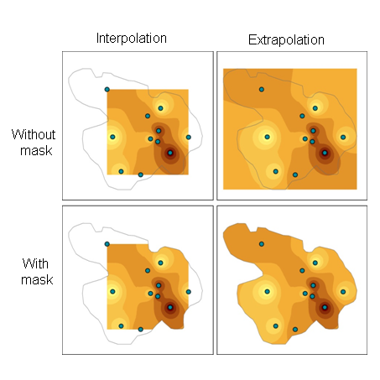
What is a spatial interpolation?
We can predict conditions at unsampled locations on the basis of information from the nearest available measured points.
Spatial interpolation when the predictions are made within the spatial extent of the measured point locations
Spatial extrapolation: predictions are made outside the spatial extent of the measured points
Notes:
QUESTION: Which method would you say is the most reliable one?
http://www.integrated-assessment.eu/eu/guidebook/spatial_interpolation_and_extrapolation_methods.html#:~:text=The%20nearest%20neighbour%20method%20uses,relative%20to%20all%20other%20points.
Given what is known as Tobler's ‘first law of geography’ – that things closer together tend to be more alike than things that are far apart – we can often predict conditions at unsampled locations on the basis of information from the nearest available measured points.
This process is called spatial interpolation when the predictions are made within the same region represented by the measured points (i.e. within the spatial extent of the measured point locations).
Spatial extrapolation is also possible, in which predictions are made outside the spatial extent of the measured points. The difference between spatial interpolation and extrapolation is illustrated in Figure 1, below.

Slide 9
What is a spatial interpolation?
Examples of spatial interpolation (or extrapolation)
1. elevation between survey benchmark locations to create a digital elevation model (DEM);
2. meteorological conditions such as precipitation or temperature at locations other than weather stations;
3. a continuous air pollution surface from a network of regulatory monitoring stations (e.g. measuring NO2, ozone, etc.)
4. indicators of water quality (e.g. salinity, temperature, dissolved oxygen) in surface water bodies based on field measurements at a set of sampling locations.
Do you have other examples?
Notes:
Air pollution: https://www.iqair.com/norway/oslo
Examples where spatial interpolation or extrapolation may be applied include estimating:

Slide 10
What is a spatial interpolation?
For a given sample of measurements {z₁,z₂,...,z_{n}}
at locations {x₁,x₂,...,x_{n}}
…the main goal is
to estimate the value z
at some new point x

Slide 11
When: Generating continuous surfaces from discrete data (samples)
Notes:
Interpolation predicts values for cells in a raster from a limited number of sample data points.
It can be used to predict unknown values for any geographic point data: elevation, rainfall, chemical concentrations, noise levels, and so on.
Some typical examples of applications for the interpolation tools.
The accompanying illustrations show the distribution and values of sample points and the raster generated from them.
The input here is a point dataset of known rainfall-level values, shown by the illustration on the left. The illustration on the right shows a raster interpolated from these points. The unknown values are predicted with a mathematical formula that uses the values of nearby known points.
Visiting every location in a study area to measure the height, magnitude, or concentration of a phenomenon is usually difficult or expensive. Instead, dispersed sample input point locations can be selected and a predicted value can be assigned to all other locations. Input points can be either randomly, strategically, or regularly spaced points containing height, concentration, or magnitude measurements.
A typical use for point interpolation is to create an elevation surface from a set of sample measurements. Each point represents a location where the elevation has been measured. The values between these input points are predicted by interpolation.

Slide 12
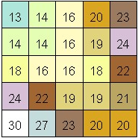
When: Generating continuous surfaces from discrete data (samples)
Raster 5 x 5
Possible solution
20
14
predicted values
16
measured values
30
20
27
Notes:
On the left is a point dataset of known values. On the right is a raster interpolated from these points.
Unknown values are predicted with a mathematical formula that uses the values of nearby known points.

Slide 13
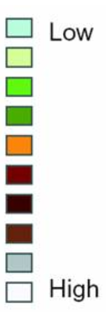
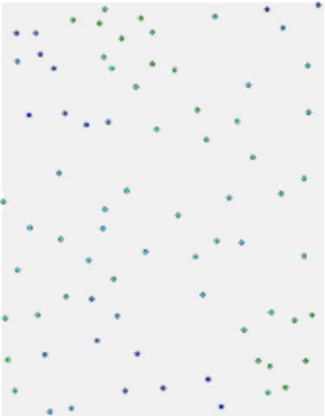
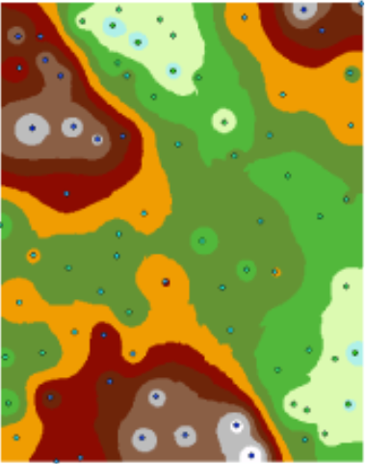
When: Generating continuous surfaces from discrete data (samples)
Elevation
The resulting grid is a prediction of what the elevation is at any location on the actual surface.
predicted values
measured values (input points)
Notes:
Visiting every location in a study area to measure the height, magnitude, or concentration of a phenomenon is usually difficult or expensive.
Instead, dispersed sample input point locations can be selected and a predicted value can be assigned to all other locations.
A typical use for point interpolation is to create an elevation surface from a set of sample measurements.
Each point represents a location where the elevation has been measured.
The values between these input points are predicted by interpolation. By interpolating, the values for each cell between these input points will be predicted.

Slide 14
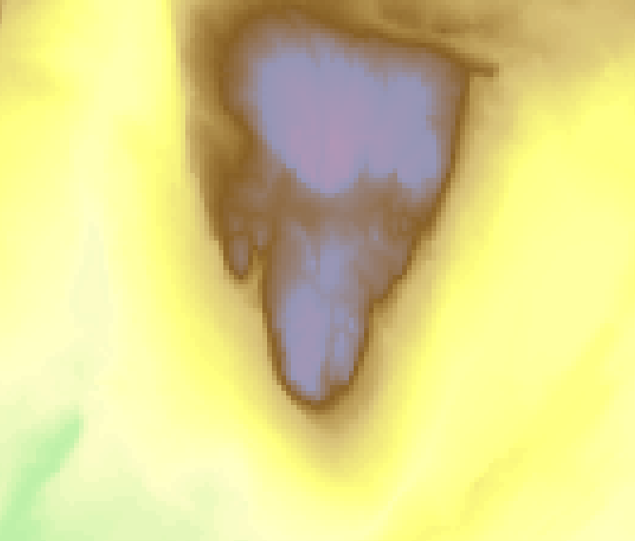
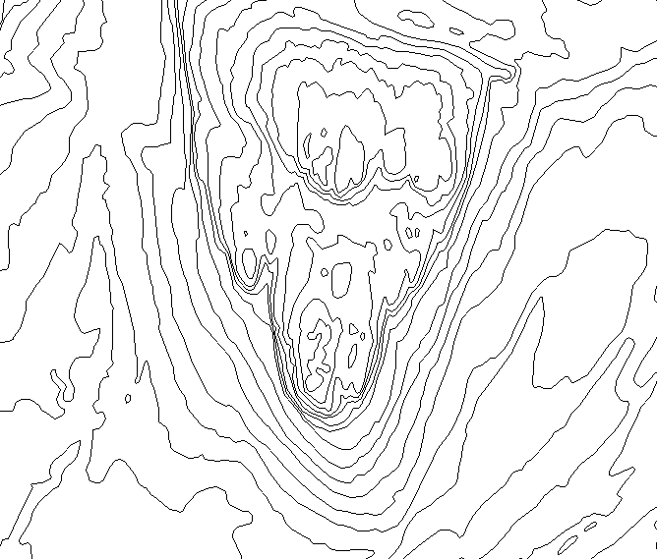
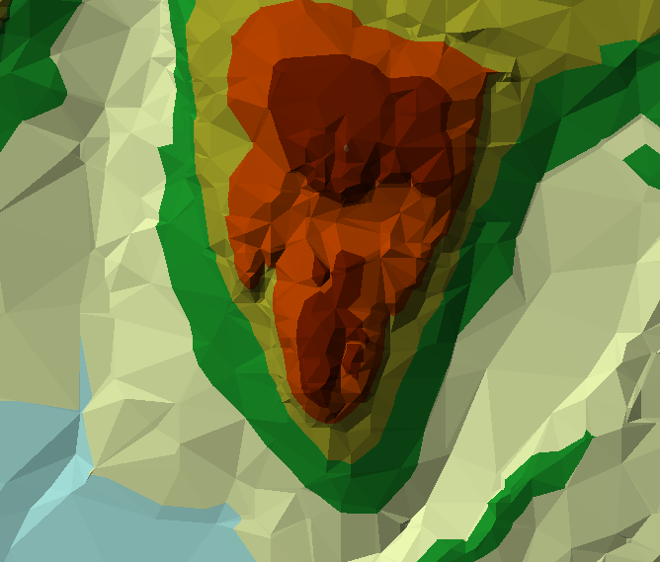
When: Conversion between data models
Vector
TIN
Grid
Notes:
We will be exploring a number of spatial interpolation methods.
Some typical examples of applications for the interpolation tools follow.
TIN = Triangulated irregular network

Slide 15
When: Changing cell size

Slide 16
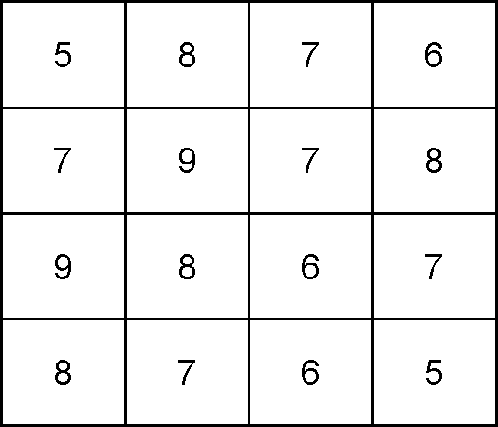
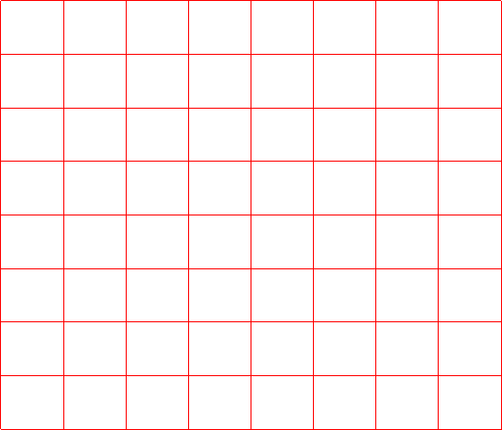

When: Changing cell size

Slide 17
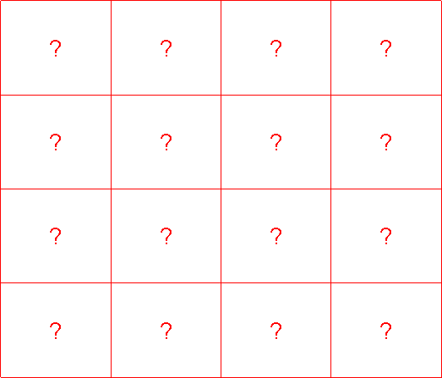
When: Transforming to another coord. sys.

Slide 18
Data sources for interpolation
Point samples of attributes measured in the field
Remote sensing (airborne and spaceborne)
Stereo images (for elevation data)

Slide 19
Spatial sampling (data/points)
Notes:
The sampling method is fundamental for the choice of subsequent interpolation methods.
Common Sampling Patterns
Two characteristics of sampling: – Location of samples – Number of samples
Sometimes we can’t control sampling. i.e. You may be limited to occurrences of an event.

Slide 20
Spatial sampling (data/points)
Two characteristics of sampling
Location of samples
Number of samples (point density)
Sometimes we can not control sampling
Cost of sampling
Available resources
You may be limited to occurrences of an event
Notes:
The sampling method is fundamental for the choice of subsequent interpolation methods.
Common Sampling Patterns
Two characteristics of sampling: – Location of samples – Number of samples
Sometimes we can’t control sampling. i.e. You may be limited to occurrences of an event.

Slide 21
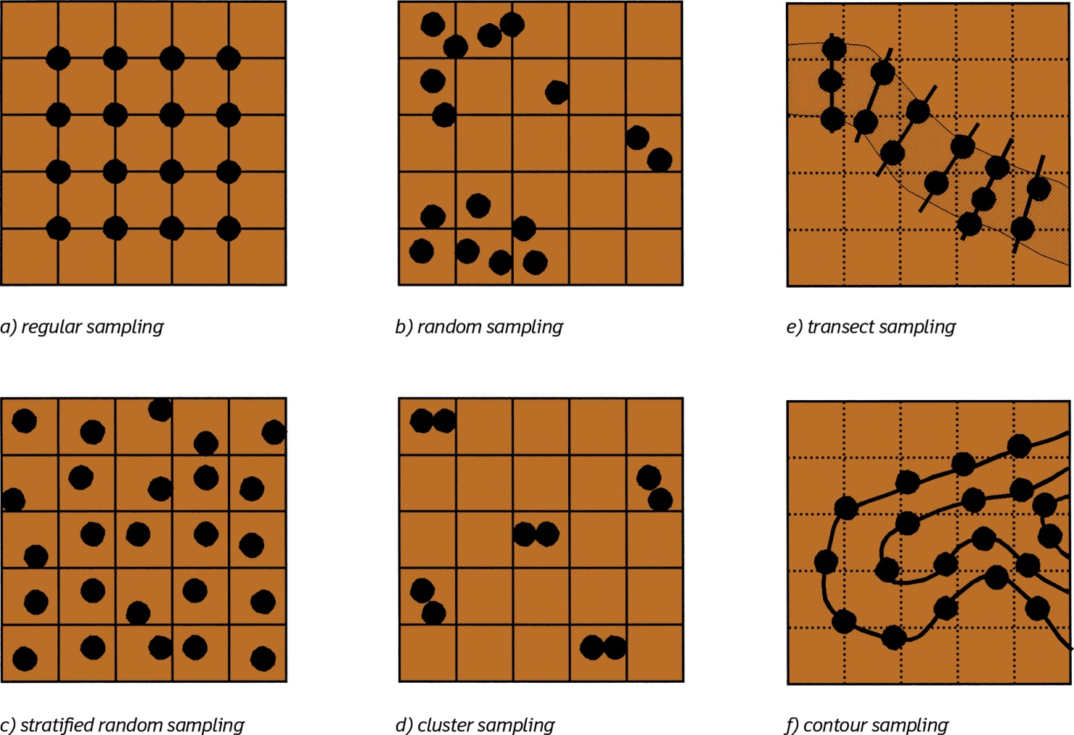
Spatial sampling: Common sampling pattern
regular sampling
random sampling
transect sampling
Burrough et al. 2015
Stratified random sampling
cluster sampling
contour sampling
Notes:
The sampling method is fundamental for the choice of subsequent interpolation methods.
Input points can be either randomly or regularly spaced or based on a sampling scheme.
Surface interpolation tools make predictions from sample measurements for all locations in an output raster dataset, whether or not a measurement has been taken at the location.

Slide 22
Learning Objectives
1
2
3
GIS interpolation
What?
When?
Data sources for interpolation
Spatial Interpolation Methods
Interpolation algorithms
Interpolation examples and application
Today’s topics

Slide 23
Spatial Interpolation Methods?
No interpolation method is superior for all datasets
Method choice depends on:
Characteristics of the sample data (variable) to be measured
Sampling pattern
Accuracy requirements of the users
Methods differ in:
the mathematical functions used to weight each observation
the number of observations used

Slide 24
How interpolate?
Deterministic vs. stochastic (statistical)
Global vs. local
Exact vs. inexact/approximation
Error estimate vs. no error estimate
Notes:
There are a variety of ways to interpolate and therefore to derive a prediction for each location;
each method is referred to as a model. With each model, there are different assumptions made of the data, and certain models are more applicable for specific data—
for example, one model may account for local variation better than another. Each model produces predictions using different calculations.
The interpolation tools are generally divided into deterministic and geostatistical methods.
The deterministic interpolation methods assign values to locations based on the surrounding measured values and on specified mathematical formulas that determine the smoothness of the resulting surface.
The deterministic methods include IDW (inverse distance weighting), Natural Neighbor, Trend, and Spline.
The geostatistical methods are based on statistical models that include autocorrelation (the statistical relationship among the measured points).
Because of this, geostatistical techniques not only have the capability of producing a prediction surface but also provide some measure of the certainty or accuracy of the predictions.
Kriging is a geostatistical method of interpolation.
They are more difficult to execute since more parameters need to be set.

Slide 25
How interpolate
Deterministic methods:
Deterministic Models use a mathematical function to predict unknown values and result in hard classification of the value of features.
Example: splines, IDW, Natural Neighbour, Trend
Statistical (geostatistical) methods:
Statistical techniques are based on statistical models that include autocorrelation: the statistical relationship among the measured points.
Provide some measure of the accuracy of the predictions.
Example: kriging
Notes:
There are effectively two types of techniques for generating raster surfaces.
The interpolation tools are generally divided into deterministic and geostatistical methods.
The deterministic interpolation methods assign values to locations based on the surrounding measured values and on specified mathematical formulas that determine the smoothness of the resulting surface.
The deterministic methods include IDW (inverse distance weighting), Natural Neighbor, Trend, and Spline.
The geostatistical methods are based on statistical models that include autocorrelation (the statistical relationship among the measured points).
Because of this, geostatistical techniques not only have the capability of producing a prediction surface but also provide some measure of the certainty or accuracy of the predictions.
Kriging is a geostatistical method of interpolation.
They are more difficult to execute since more parameters need to be set.

Slide 26
How interpolate
Global interpolators
Use all available data to provide predictions
Used for examining trends
Local interpolators
Operate within a small zone around the point being interpolated

Slide 27
How interpolate
Inexact interpolation:
The measured value is not reproduced
In these methods the differences between measured and predicted values can be used as an indicator of the quality
Exact interpolation:
The predicted value at a sample point is identical to the measured value
In these methods we may use an independent dataset to test the quality

Slide 28
Interpolation algorithms
Trend surfaces (global polynomial interpolation, GPI)
Nearest neighbour (Thiessen)
Inverse distance weighting (IDW) (moving average)
Radial basis functions or Spline
Kriging (ordinary, simple, universal, etc.…analyses of spatial variation)
next lecture

Slide 29
Interpolation algorithms
Trend surfaces (global polynomial interpolation, GPI)
Nearest neighbour (Thiessen)
Inverse distance weighting (IDW) (moving average)
Radial basis functions or Spline
Kriging (ordinary, simple, universal, etc.…analyses of spatial variation)
Notes:
Trend is a global polynomial interpolation that fits a smooth surface defined by a mathematical function (a polynomial) to the input sample points.

Slide 30
Interpolation algorithms: Trend surfaces
Fit a polynomial line f(x) or surface f(x,y) by least squares through the sampled points.
Trend is based on regression. Regression analysis is the optimized fitting of a line or curve to derive a mathematical function that best fits the raw data.
Linear example: z (x) = b0 + b1x + ε
where b0 is the intercept, b1 is the slope and ε is the residual (noise)
By increasing the number of terms it is possible to fit any set of points by a complicated curve, thereby reducing ε to zero
Surface example (two dimensions): linear: z (x, y) = b0 + b1x + b2y quadratic (polynomial regression): z (x, y) = b0 + b1x + b2y + b3x2 + b4xy + b5y2
Notes:
Ett polynom är ett matematiskt uttryck bestående av icke-negativa heltalspotenser av variabler och konstanter kombinerade genom enbart addition, subtraktion och multiplikation. Uttryckets högsta heltalspotens är polynomets gradtal. Exempelvis är
x 2 − 4 x + 5 x^2 - 4x + 5
ε = epsilon
The simplest way to model long-range spatial variation is by a multiple regression of attribute values versus geographical location.
Trend surfaces are smoothing functions, rarely passing exactly through the original data points unless these are few and the order of the surface is high.

Slide 31
Interpolation algorithms: Trend surfaces
Linear interpolation
Least square fit
the sum of the squared distances between the predicted and the measured points is minimised
z (x) = b0 + b1x + ε
where b0 is the intercept, b1 is the slope and ε is the residual (noise)
?

Slide 32
Interpolation algorithms: Trend surfaces
Linear interpolation

Slide 33
Interpolation algorithms: Trend surfaces
Linear interpolation

Slide 34
Interpolation algorithms: Trend surfaces
Linear interpolation

Slide 35
Interpolation algorithms: Trend surfaces
Linear interpolation

Slide 36
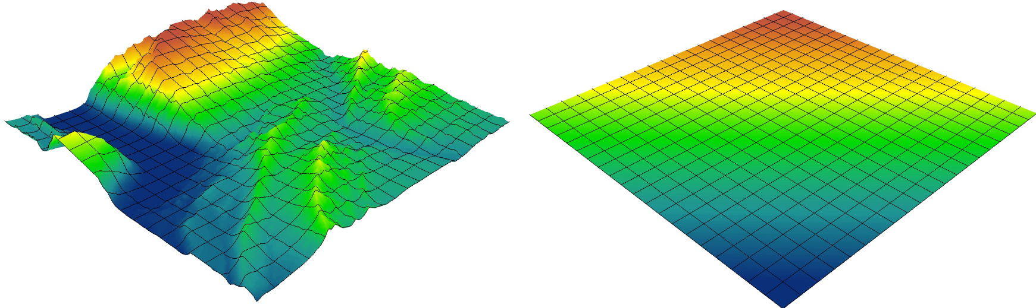
Interpolation algorithms: Trend surfaces
Surface interpolation: Trend spatial interpolation is just regression in two dimensions
Actual landscape
First-order (y = x); some constant value
By Alan kasprak
The higher-order polynomial, the more complex terrain you can reproduce (but it takes more time)

Slide 37
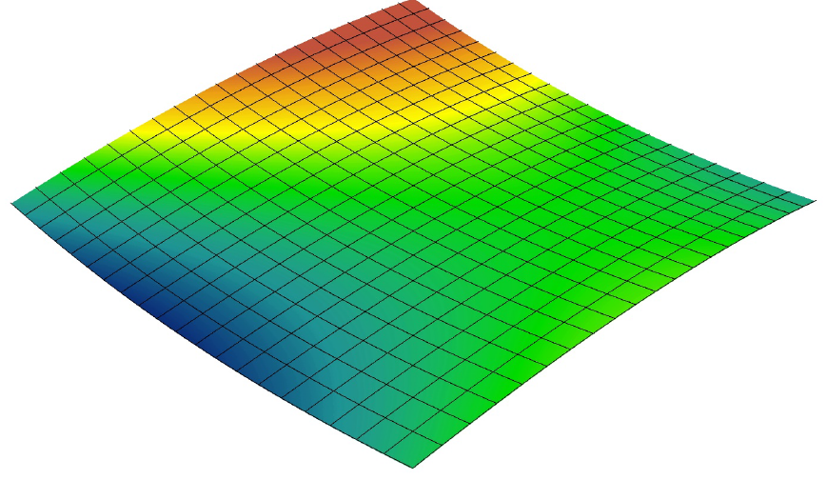
Interpolation algorithms: Trend surfaces
Surface interpolation: Trend spatial interpolation is just regression in two dimensions
Actual landscape
second-order (y = x²+ x)
By Alan kasprak
The higher-order polynomial, the more complex terrain you can reproduce (but it takes more time)

Slide 38
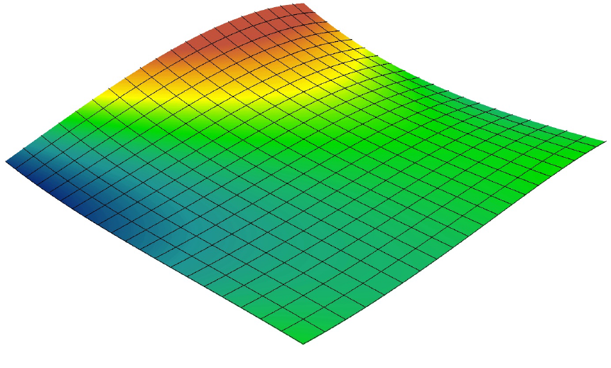
Interpolation algorithms: Trend surfaces
Surface interpolation: Trend spatial interpolation is just regression in two dimensions
Actual landscape
third-order (y = x³+ x² + x)
By Alan kasprak
The higher-order polynomial, the more complex terrain you can reproduce (but it takes more time)

Slide 39
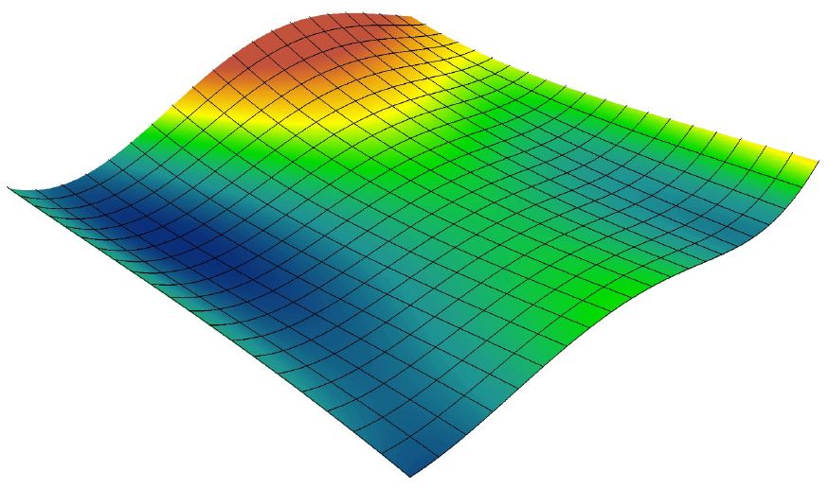
Interpolation algorithms: Trend surfaces
Surface interpolation: Trend spatial interpolation is just regression in two dimensions
Actual landscape
fourth-order (y = x⁴+ x³+ x² + x)
By Alan kasprak
The higher-order polynomial, the more complex terrain you can reproduce (but it takes more time)

Slide 40
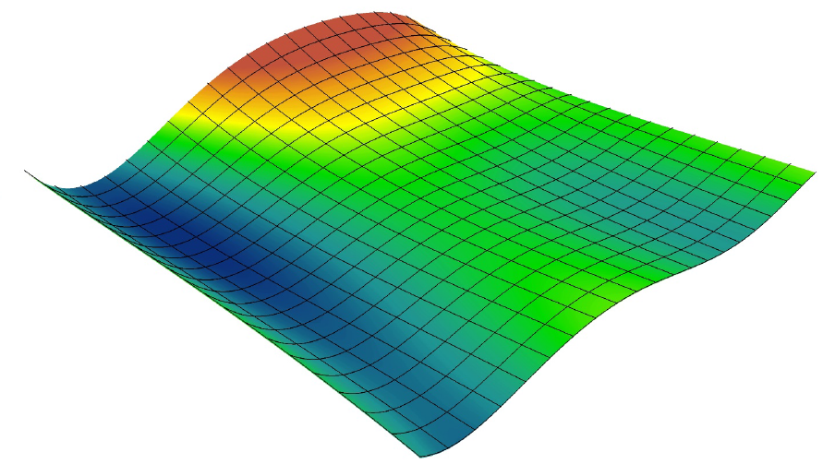
Interpolation algorithms: Trend surfaces
Surface interpolation: Trend spatial interpolation is just regression in two dimensions
Actual landscape
fifth-order (y = x⁵+ x⁴+ x³+ x² + x)
By Alan kasprak
The higher-order polynomial, the more complex terrain you can reproduce (but it takes more time)

Slide 41
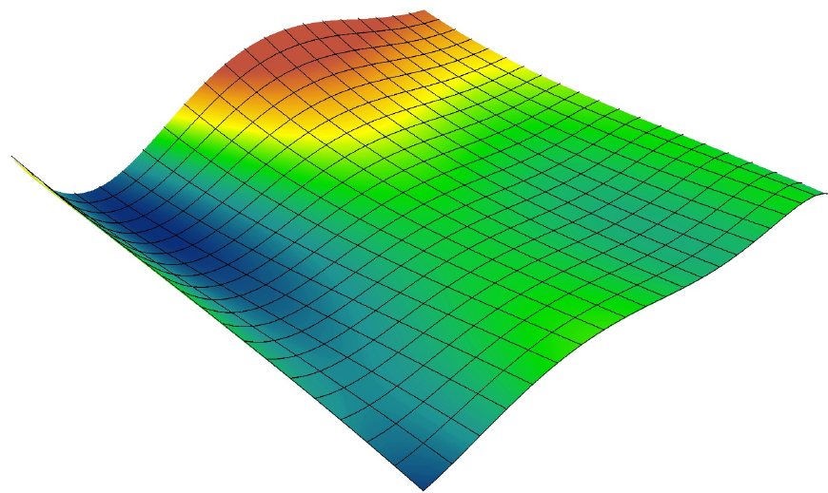
Interpolation algorithms: Trend surfaces
Surface interpolation: Trend spatial interpolation is just regression in two dimensions
Actual landscape
sixth-order (y = x⁶+ x⁵+ x⁴+ x³+ x² + x)
By Alan kasprak
The higher-order polynomial, the more complex terrain you can reproduce (but it takes more time)

Slide 42
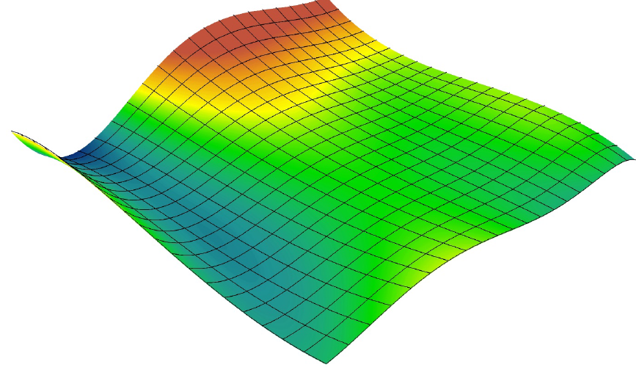
Interpolation algorithms: Trend surfaces
Surface interpolation: Trend spatial interpolation is just regression in two dimensions
Actual landscape
seventh-order (y = x⁷+ x⁶+ x⁵+ x⁴+ x³+ x² + x)
By Alan kasprak
The higher-order polynomial, the more complex terrain you can reproduce (but it takes more time)
Notes:
The trend surface changes gradually and captures coarse-scale patterns in the data.

Slide 43
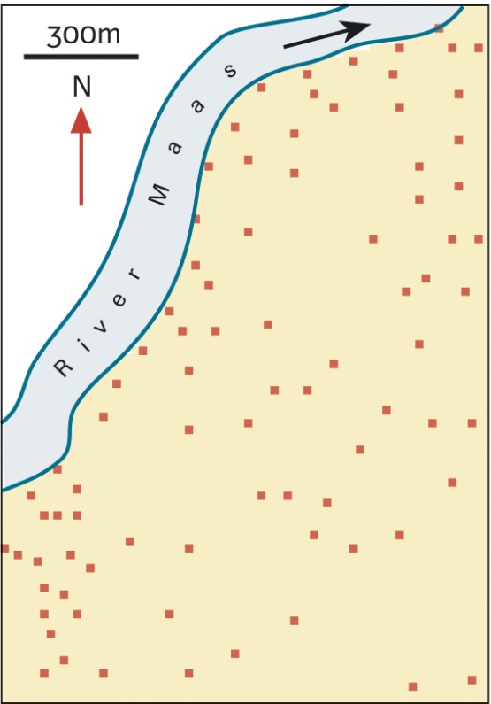
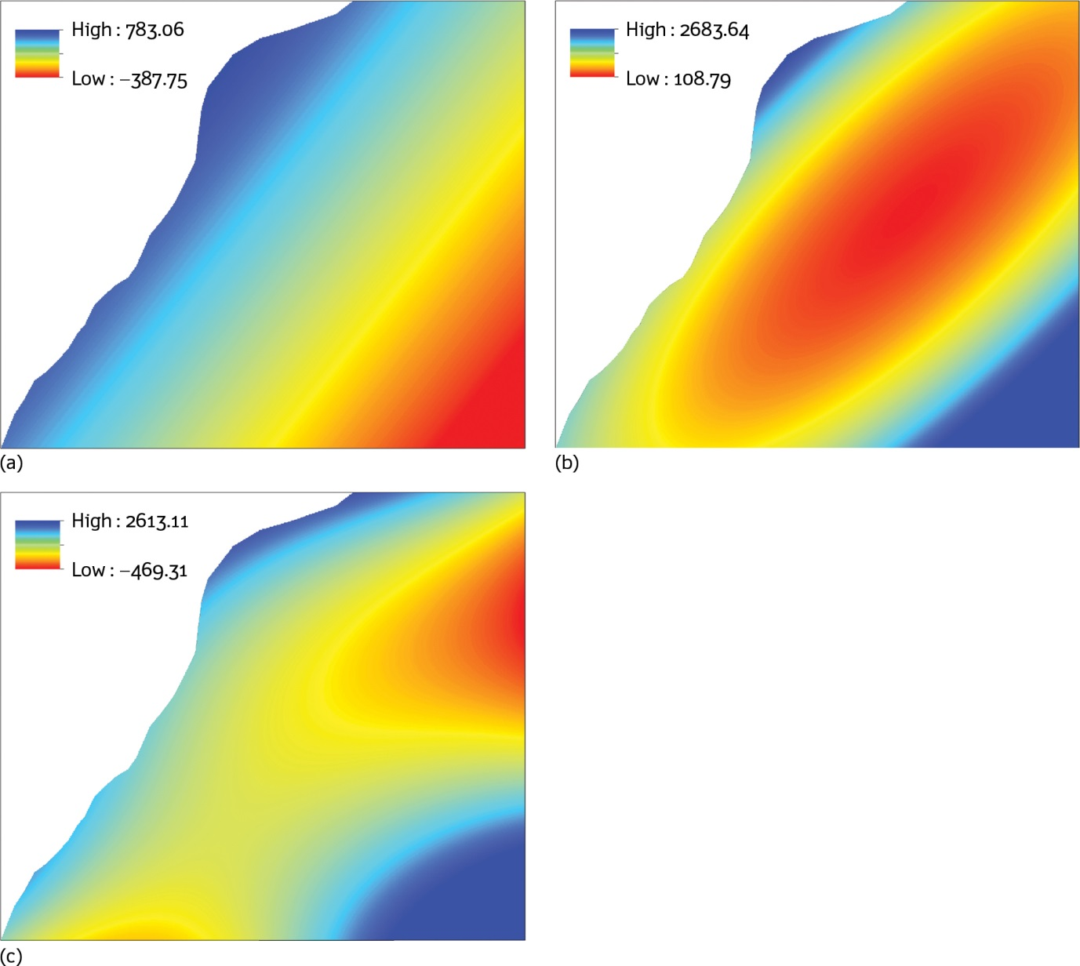
Interpolation algorithms: Trend surfaces
Zinc sample data
Trend surface
first order
second order
third order
Burrough et al. 2015
Notes:
QUESTION: What is wrong in the pictures?
Negative values should not exist here.

Slide 44
Interpolation algorithms: Trend surfaces
Trend interpolation is useful when conditions vary gradually over relatively broad areas (when the surface varies gradually from region to region over the area of interest).
Elevation is a bad example
Atmospheric conditions (temperature, humidity, pollution, etc.) and aquatic conditions (temperature, pH, salinity) are good examples
Broad features can be modelled with low-order surfaces
Examining or removing the effects of global trends
Difficult to describe a physical meaning to complex higher order polynomials.
Higher-order polynomials will always increase the model fit, but at the risk of over-fitting your model and takes more time to interpolate
Susceptible to edge effects (do not extrapolate!) and to outliers (extremely high and low values)
Notes:
Trend interpolation is used for: Fitting a surface to the sample points when the surface varies gradually from region to region over the area of interest—for example, pollution over an industrial area. Examining or removing the effects of long-range or global trends. In such circumstances, the technique is often referred to as trend surface analysis.
Trend interpolation creates a gradually varying surface using low-order polynomials that describe a physical process—for example, pollution and wind direction.
However, the more complex the polynomial, the more difficult it is to ascribe physical meaning to it.
Furthermore, the calculated surfaces are highly susceptible to outliers (extremely high and low values), especially at the edges.
Therefore, analysis confined within a bounded study region may well be biased because of the ignorance of the outside of the study region as well as the inappropriateness of the theories. This problem of potential bias in spatial analysis is referred to as edge effects (or boundary effects).

Slide 45
Interpolation algorithms
Trend surfaces (global polynomial interpolation, GPI)
Nearest neighbour (Thiessen)
Inverse distance weighting (IDW) (moving average)
Radial basis functions or Spline
Kriging (ordinary, simple, universal, etc.…analyses of spatial variation)

Slide 46
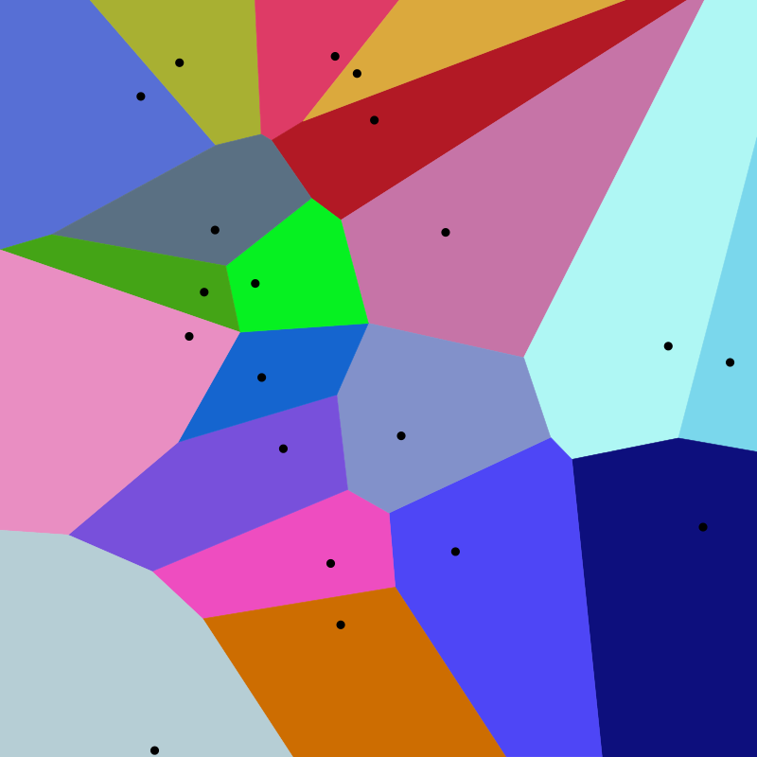
Interpolation algorithms: Nearest neighbour
Assign to all unsampled locations the value of the closest sampled location
Voronoi diagram (Thiessen polygons)
Voronoi diagram is a partition of a plane into regions close to each of a given set of point {p₁, ..., p_{n}}
For each point there is a corresponding region consisting of all points of the plane closer to that point than to any other.
The regions (Voronoi cells) are known as Thiessen polygons (R_{k})
Black dots are random set of points in 2D
Notes:
The nearest neighbour method uses Thiessen or Voronoi polygons
This is probably the simplest (and possibly one of the oldest) interpolation method. It was introduced by Alfred H. Thiessen more than a century ago.
The goal is simple: Assign to all unsampled locations the value of the closest sampled location.
This generates a tessellated surface whereby lines that split the midpoint between each sampled location are connected thus enclosing an area. Each area ends up enclosing a sample point whose value it inherits.
every unsampled location is thus assigned the value of its nearest measurement point.
Black dots are random set of points in 2D. This Voronoi diagram is an example of nearest neighbor interpolation of a random set of points
The method of Thiessen polygons defines a polygon around each point such that any location within a particular polygon is nearer to that polygon's point than to any other point, and therefore, has the same value.
Thiessen polygons have boundaries that define the area that is closest to each point relative to all other points. This property is mathematically defined by the perpendicular bisectors of the lines between all input data points. In this case
The nearest neighbor interpolation (NNI) is a very simple interpolation approach.
Nearest neighbour interpolation is the simplest approach to interpolation. Rather than calculate an average value by some weighting criteria or generate an intermediate value based on complicated rules, this method simply determines the “nearest” neighbouring pixel, and assumes the intensity value of it.
Recall that interpolation seeks for a given sample of observations {z1,z2,...,zn} at locations {x1,x2,...,xn} to estimate the value z at some new point x.
The NNI approach uses the value zi that is closest to x. Thus, the algorithm seeks to find i such that |xi−x| is minimized, then the estimate of z is zi.
It should be noted that the set of closest points to xi forms a Thiessen polygon, also known as Voronoi polygon. The technique used to compute these polygons is referred to as Delauny triangulation. Such a particular polygon corresponds to a region consisting of all points closer to xi than to any other x.
https://www.geo.fu-berlin.de/en/v/soga/Geodata-analysis/geostatistics/Nearest-neighbor/index.html
The nearest neighbor interpolation (NNI) is a very simple interpolation approach. Recall that interpolation seeks for a given sample of observations {z1,z2,...,zn} at locations {x1,x2,...,xn} to estimate the value z at some new point x.
Hartmann, K., Krois, J., Waske, B. (2018)
This Voronoi diagram is an example of nearest neighbor interpolation of a random set of points
The method of Thiessen polygons defines a polygon around each point such that any location within a particular polygon is nearer to that polygon's point than to any other point, and therefore, has the same value.
In the simplest case we are given a finite set of points {p₁, ..., p_{n}} in the Euclidean plane. In this case each site p_{k} is simply a point, and its corresponding Voronoi cell R_{k} consists of every point in the Euclidean plane whose distance to p_{k} is less than or equal to its distance to any other p_{k}.

Slide 47
Interpolation algorithms: Nearest neighbour
Voronoi diagram (Thiessen polygons)
The line segments of the Voronoi diagram are all the points in the plane that are equidistant to the two nearest sites.
The Voronoi vertices (nodes) are the points equidistant to three (or more) sites.
Notes:
Polygons with variable number of segments that enclose all the points placed at the minimum distance from the center of the polygon

Slide 48
Interpolation algorithms: Nearest neighbour
Voronoi diagram (Thiessen polygons)
Assigns a value to an unsampled location that is equal to the value found at the nearest sample location
The predicted value is equal to the value of the nearest sample point
Exact interpolator: Value at each sample point is preserved.
No variation within polygons
Not appropriate for gradually varying phenomena
Suitable for qualitative data
Notes:
QUESTION: What type of data would qualify as qualitative data?
https://www.geo.fu-berlin.de/en/v/soga/Geodata-analysis/geostatistics/Nearest-neighbor/index.html
The nearest neighbor interpolation (NNI) is a very simple interpolation approach. Recall that interpolation seeks for a given sample of observations {z1,z2,...,zn} at locations {x1,x2,...,xn} to estimate the value z at some new point x.
Hartmann, K., Krois, J., Waske, B. (2018)

Slide 49
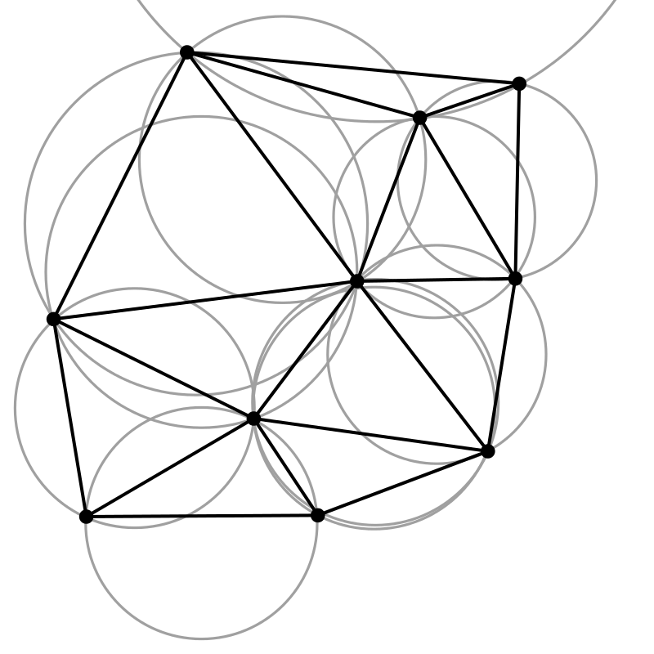
Interpolation algorithms: Nearest neighbour
Relationship of the Voronoi diagram with Delaunay triangulation
The vertices of the Voronoi diagram are the circumcenters of Delaunay triangles
The triangles satisfies the "Delaunay condition", i.e., that the circumcircles of all triangles have empty interiors
A Delaunay triangulation in the plane with circumcircles shown
Notes:
https://en.wikipedia.org/wiki/Delaunay_triangulation
Thiessen polygons or diagrams of Voronoi.
Polygons with variable number of lines that enclose all the points placed at the minimum distance from the center of the polygon
The lines joining the data points show the Delaunay triangulation, which is the same topology as a TIN.

Slide 50
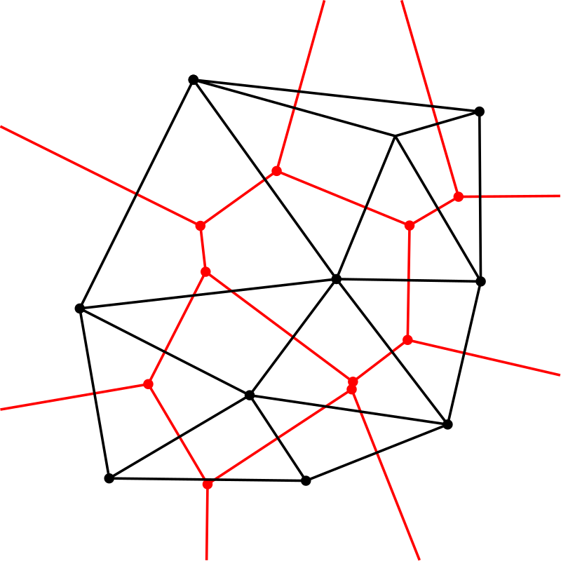
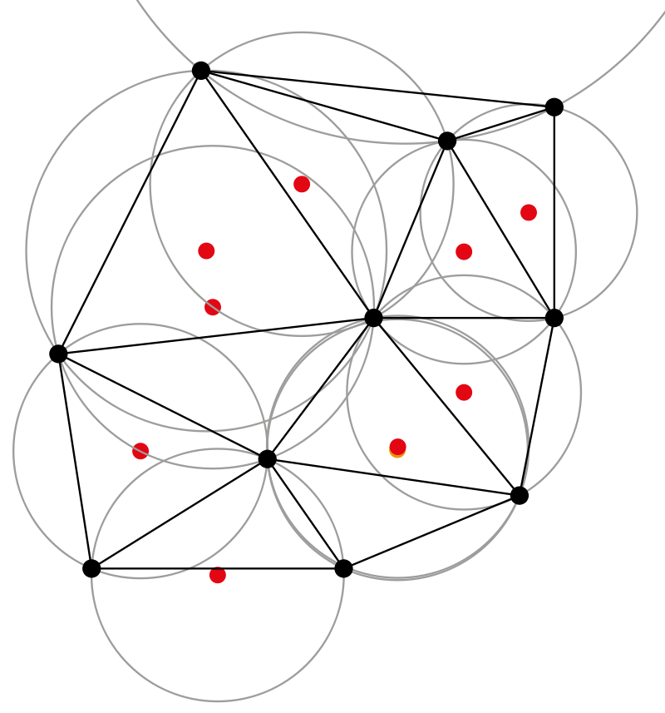
Interpolation algorithms: Nearest neighbour
Relationship of the Voronoi diagram with Delaunay triangulation
The Delaunay triangulation with all the circumcircles and their centers (in red)
Connecting the centers of the circumcircles produces the Voronoi diagram (in red).

Slide 51
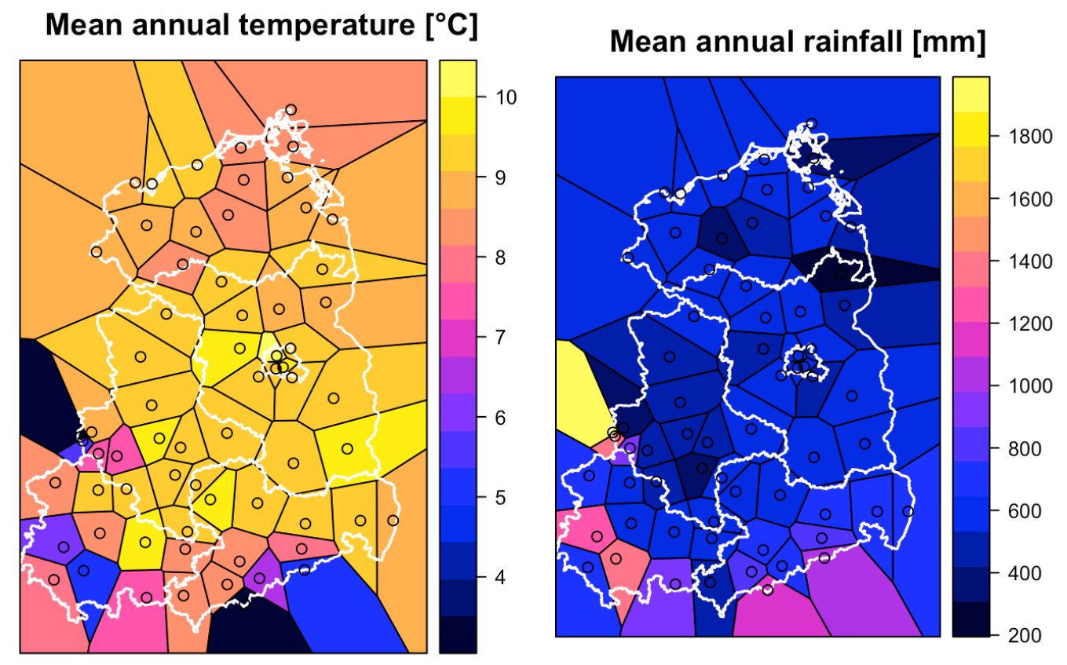
Interpolation algorithms: Nearest neighbour
Voronoi polygons for the weather station data set in Germany
What is the problematic aspect of this approach ?
The surface values change abruptly across the tessellated boundaries
Brundson and Comber, 2015
Notes:
https://www.geo.fu-berlin.de/en/v/soga/Geodata-analysis/geostatistics/Nearest-neighbor/index.html
Let us compute the Voronoi polygons for the weather station data set in particular for the mean annual temperature and the mean annual rainfall in East Germany
Looking at the plots it becomes obvious that a problematic aspect of this approach is that the interpolated surfaces are discontinuous, and these discontinuities are an artifact of the locations of the samples.
One problem with this approach is that the surface values change abruptly across the tessellated boundaries. This is not representative of most surfaces in nature.

Slide 52
Interpolation algorithms
Trend surfaces (global polynomial interpolation, GPI)
Nearest neighbour (Thiessen)
Inverse distance weighted (IDW) (moving average)
Radial basis functions or Spline
Kriging (ordinary, simple, universal, etc.…analyses of spatial variation)

Slide 53
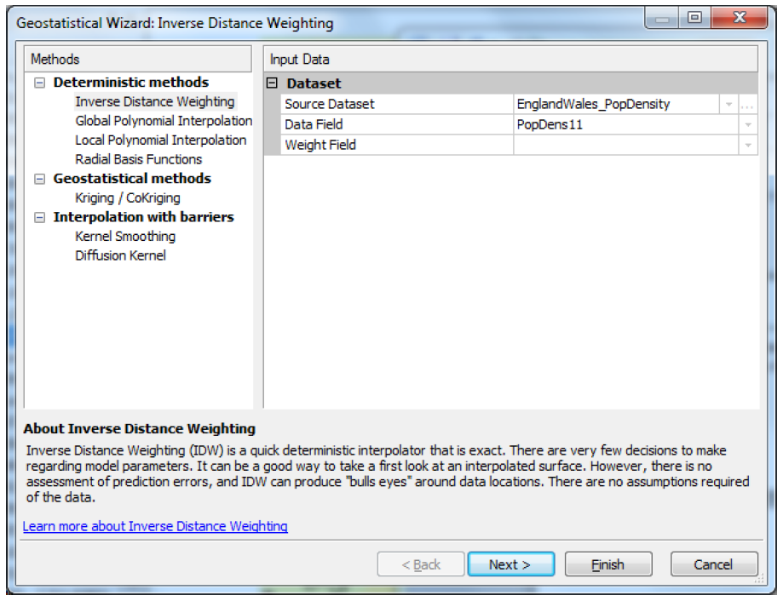
Interpolation algorithms: IDW
Inverse distance weighting (IDW) or weighted moving average
Notes:
http://www.integrated-assessment.eu/eu/guidebook/spatial_interpolation_and_extrapolation_methods.html#:~:text=The%20nearest%20neighbour%20method%20uses,relative%20to%20all%20other%20points.
Inverse distance weighting (IDW) combines the notion of proximity with that of gradual change of the trend surface.
IDW relies on the assumption that the value at an unsampled location is a distance-weighted average of the values from surrounding data points, within a specified window.
The points closest to the prediction location are assumed to have greater influence on the predicted value than those further away, such that the weight attached to each point is an inverse function of its distance from the target location.
The parameter b is the weight parameter that is applied as an exponent to the distance thus amplifying the irrelevance of a point at location i as distance to j increases.

Slide 54
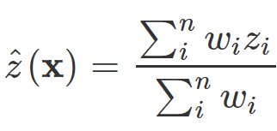
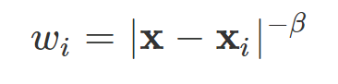
Interpolation algorithms: IDW
Inverse distance weighting (IDW) or weighted moving average
The predicted value at any point is the weighted average of the surrounding points
where
where:
β ≥0
β is the inverse distance power (or power coefficient)
|x-x_{i}| is the euclidean distance
n is the number of surrounding points to be included
Notes:
what do you know about that? What is the basic concept of this interpolation procedure?
The points closest to the prediction location are assumed to have greater influence on the predicted value than those further away, such that the weight attached to each point is an inverse function of its distance from the target location.
The parameter b is the weight parameter that is applied as an exponent to the distance thus amplifying the irrelevance of a point at location i as distance to j increases.
https://www.geo.fu-berlin.de/en/v/soga/Geodata-analysis/geostatistics/Inverse-Distance-Weighting/index.html
In the inverse distance weighting (IDW) approach, also referred to as inverse distance-based weighted interpolation,
the estimation of the value z at location x is a weighted mean of nearby observations.
The IDW technique computes an average value for unsampled locations using values from nearby weighted locations.
The weights are proportional to the proximity of the sampled points to the unsampled location and can be specified by the IDW power coefficient.
The inverse distance powe β, determines the degree to which the nearer point(s) are preferred over more distant points. Typically β=1 or β=2 corresponding to an inverse or inverse squared relationship.
The number of surrounding points, n, to be included decides whether a global or local weighting is applied.
If the point x coincides with an observation location (x=xi), then the observed value, x, is returned to avoid infinite weights.
The larger the power coefficient, the stronger the weight of nearby points as can be gleaned from the following equation that estimates the value z at an unsampled location j:

Slide 55
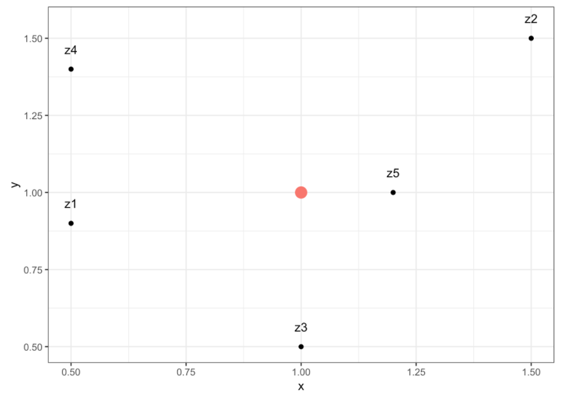
Interpolation algorithms: IDW
Example: Inverse distance weighting (IDW)
ID x y z
z0 1.0 1.0 ?
z1 0.5 0.9 1
z2 1.5 1.5 3
z3 1.0 0.5 5
z4 0.5 1.4 7
z5 1.2 1.0 7
z0
Notes:
Let us gain intuition on the IDW by applying it on a toy example.
Given below are five points z1, z2, z3, z4 z5 and one point z0, which we want to predict, where z∈R2.
The planar coordinates of each point z are given in the columns x and y, and the actual value associated to each point is given in column z.

Slide 56
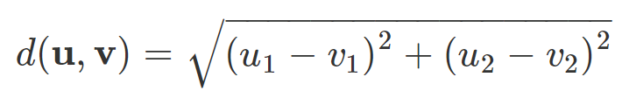
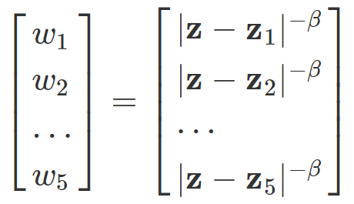
Interpolation algorithms: IDW
Example: Inverse distance weighting (IDW)
ID x y z
z0 1.0 1.0 ?
z1 0.5 0.9 1
z2 1.5 1.5 3
z3 1.0 0.5 5
z4 0.5 1.4 7
z5 1.2 1.0 7
The euclidean distance, d, between two points (u,v) in a plane (R2) is given by
You can compute w_{i} as follow. Consider β=2 and n=5

Slide 57
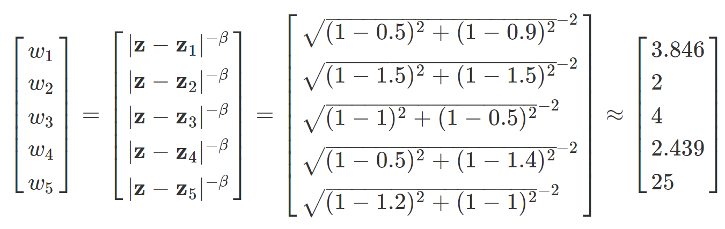
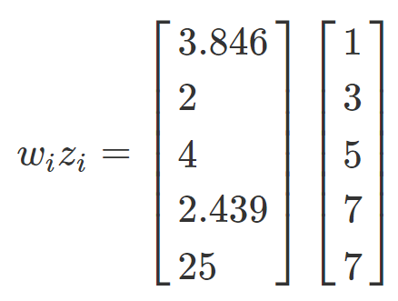
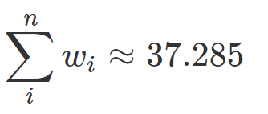
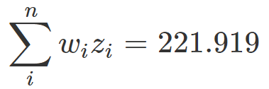
Interpolation algorithms: IDW
Example: Inverse distance weighting (IDW)
ID x y z
z0 1.0 1.0 ?
z1 0.5 0.9 1
z2 1.5 1.5 3
z3 1.0 0.5 5
z4 0.5 1.4 7
z5 1.2 1.0 7
Hence:

Slide 58
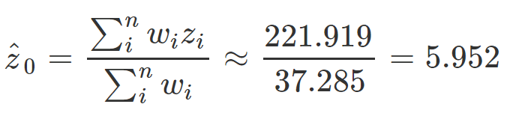
Interpolation algorithms: IDW
Example: Inverse distance weighting (IDW)
ID x y z
z0 1.0 1.0 ?
z1 0.5 0.9 1
z2 1.5 1.5 3
z3 1.0 0.5 5
z4 0.5 1.4 7
z5 1.2 1.0 7
Plugging the numerator and the denominator into the equation from above yields
ID x y z
z0 1.0 1.0 5.952
Notes:
The parameter b is the weight parameter that is applied as an exponent to the distance thus amplifying the irrelevance of a point at location i as distance to j increases.
So a large b results in nearby points wielding a much greater influence on the unsampled location than a point further away resulting in an interpolated output looking like a Thiessen interpolation.
On the other hand, a very small value of b will give all points within the search radius equal weight such that all unsampled locations will represent nothing more than the mean values of all sampled points within the search radius

Slide 59
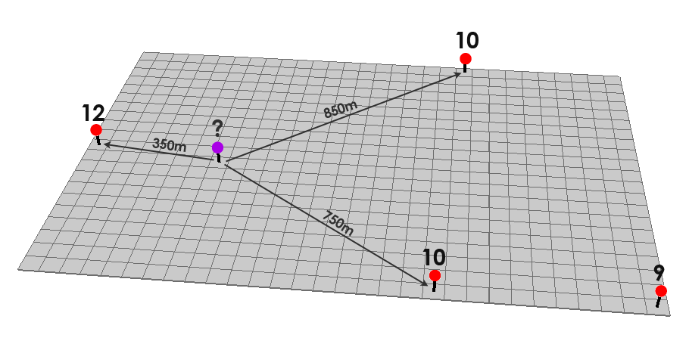
Interpolation algorithms: IDW
Example: Inverse distance weighting (IDW)
GISGeography.com
Notes:
The illustration shows how the elevation of a given point P can be estimated by averaging the known elevations of nearby points, while taking into account their distance from point P.

Slide 60
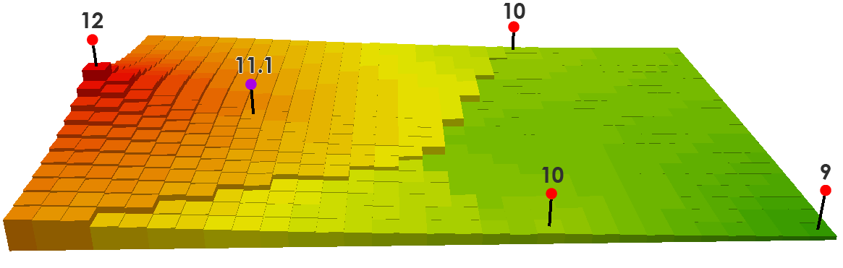
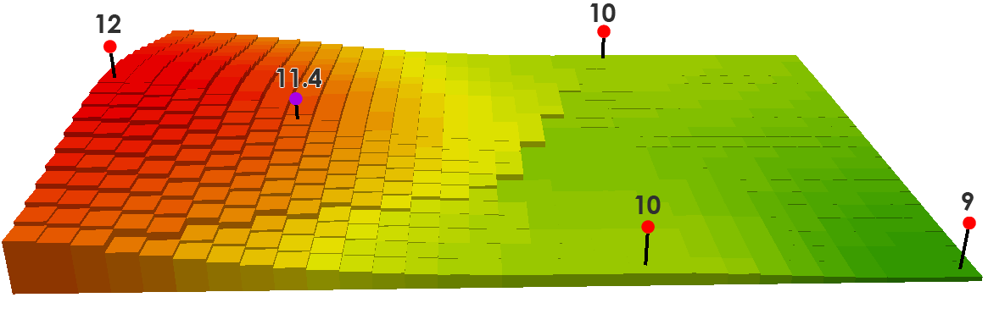
Interpolation algorithms: IDW
For a power of 1, that cell value is equal to: ((12/350) + (10/750) + (10/850)) / ((1/350) + (1/750) + (1/850)) = 11.1
For a power of 2, that cell value is equal to:
((12/350²) + (10/750²) + (10/850²)) / ((1/350²) + (1/750²) + (1/850²)) = 11.4
GISGeography.com
Notes:
You may want to explore the effect of changing some of the parameters of the interpolation (e.g., for IDW, you could explore the effect of increasing or decreasing the minimum and maximum number of neighbours to include, or the value of the power term for the weighting function, e.g. 1.5, 2.5, 3, etc –
power = 1 would make the distance decay function is linear one.

Slide 61
Interpolation algorithms: IDW
The r value controls the level of relative spatial dependency (low r value)

Slide 62
Interpolation algorithms: IDW
The r value controls the level of relative spatial dependency (low r value)

Slide 63
Interpolation algorithms: IDW
“Duck-egg” pattern appear around solitary data points that differ greatly from their surroundings

Slide 64
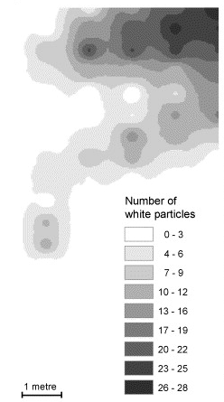
Interpolation algorithms: IDW
“Duck-egg” pattern
(McKinley and Ruffell 2006)

Slide 65
Interpolation algorithms: IDW
Works well in some cases
(McKinley and Ruffell 2006)

Slide 66
Interpolation algorithms: IDW
Outlier effects
(McKinley and Ruffell 2006)

Slide 67
Interpolation algorithms: IDW
Terracing effects may also occur (especially for high r values)
(McKinley and Ruffell 2006)

Slide 68
Interpolation algorithms
Trend surfaces (global polynomial interpolation, GPI)
Nearest neighbour (Thiessen)
Inverse distance weighting (IDW) (moving average)
Radial basis functions or spline
Kriging (ordinary, simple, universal, etc.…analyses of spatial variation)

Slide 69
Interpolation algor.: Radial basis functions
Radial basis functions are a series of exact interpolation techniques i.e. the surface must pass through each measured sample value.
There are five different basis functions:
Thin-plate spline
Spline with tension
Completely regularized spline
Multiquadric function
Inverse multiquadric function
Radial basis functions methods are a special case of splines.
Notes:
https://pro.arcgis.com/en/pro-app/latest/help/analysis/geostatistical-analyst/how-radial-basis-functions-work.htm

Slide 70
Interpolation algor.: Radial basis functions
Splines
Piece-wise functions
Fitted exactly to a small number of data points
Joins between one part of the curve and another are continuous
Bicubic spline
Three dimensional (surface)
The resulting smooth surface passes exactly through the input points.
Thin-plate spline
Exact spline surface is replaced by a locally smoothed average
Notes:
Splines are piece-wise polynomial functions that are fitted together to provide a complete, yet complex, representation of the surface between the measurement points.
Functions are fitted exactly to a small number of points while, at the same time, ensuring that the joins between different parts of the curve are continuous and have no disjunctions.
Splines are often useful for calculating smooth surfaces from a large number of input data points and often produce good results for gently varying surfaces such as elevation.
Thin plate splines are a special form of spline, which have particular value in interpolation.
These, in effect, replace the exact spline surface with a locally smoothed average which passes as close as possible through the data points.
They can be used to remove artifacts (e.g. excessively high or low predicted values) resulting from natural variation and measurement error in the input data.

Slide 71
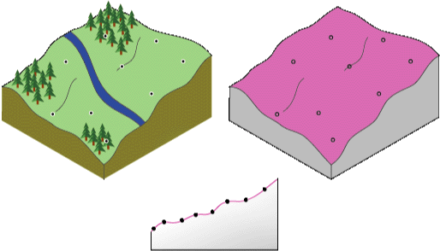
Interpolation algor.: Radial basis functions
Radial basis functions are a series of exact interpolation techniques i.e. the surface must pass through each measured sample value.
sample value
Radial basis functions surface
Cross section illustrating how RBF surface fits through the sample values
the surface passes through the data values
Notes:
The following diagram illustrates conceptually how an RBF surface fits through a series of elevation sample values. Notice in the cross section, the surface passes through the data values.

Slide 72


Interpolation algor.: Radial basis functions
Difference between Radial basis functions (RBF) and Inverse Distance Weighted (IDW )
Example RBF profile
Example IDW profile
Notes:
QUESTION: Do you notice any difference between maximum and minimum values?
https://pro.arcgis.com/en/pro-app/latest/help/analysis/geostatistical-analyst/how-radial-basis-functions-work.htm
Global and local polynomial interpolators, which are both inexact interpolators that do not require the surface to pass through the measured points.
RBF and IDW are exact interpolators.
The Inverse Distance Weighted (IDW) and Spline methods are referred to as deterministic interpolation methods because they are directly based on the surrounding measured values or on specified mathematical formulas that determine the smoothness of the resulting surface.
When comparing an RBF to IDW (which is also an exact interpolator), IDW will never predict values above the maximum measured value or below the minimum measured value as you can see in the cross section of a transect of sample data below.
However, the RBFs can predict values above the maximum and below the minimum measured values as in the cross section below.

Slide 73
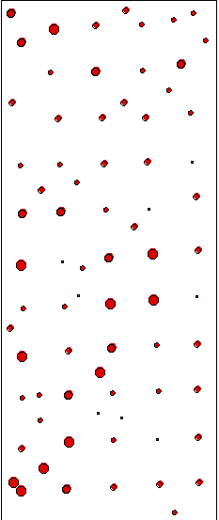
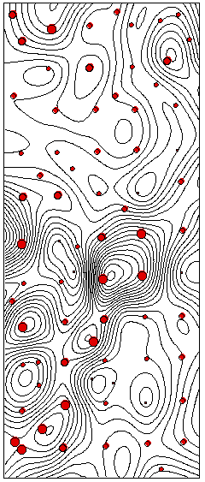
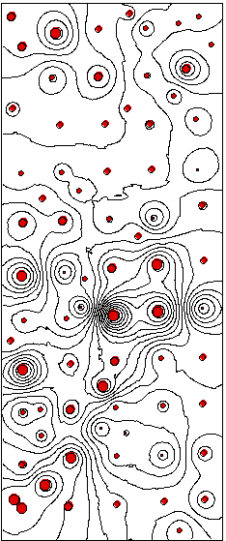
Interpolation algor.: Radial basis functions
Point data
Spline result
IDW result

Slide 74
Interpolation algor.: Radial basis functions
RBFs are used to produce smooth surfaces from a large number of data points.
The functions produce good results for gently varying surfaces such as elevation.
The techniques are inappropriate when
large changes in the surface values occur within short distances
the sample data is prone to measurement error or uncertainty
Notes:
https://pro.arcgis.com/en/pro-app/latest/help/analysis/geostatistical-analyst/how-radial-basis-functions-work.htm
Global and local polynomial interpolators, which are both inexact interpolators that do not require the surface to pass through the measured points.
When comparing an RBF to IDW (which is also an exact interpolator), IDW will never predict values above the maximum measured value or below the minimum measured value as you can see in the cross section of a transect of sample data below.

Slide 75
Interpolation algorithms
Trend surfaces
Nearest neighbour (Thiessen)
Inverse distance interpolation / weighted moving average (IDW)
Spline/local polynomials
Kriging (analyses of spatial variation)
next lecture

Slide 76
Summary of interpolation tool
Tool | Description
Trend | Interpolates a raster surface from points using a trend technique.
Natural Neighbour | Interpolates a raster surface from points using a natural neighbour technique.
IDW | Interpolates a raster surface from points using an inverse distance weighted (IDW) technique.
Spline | Interpolates a raster surface from points using a two-dimensional minimum curvature spline technique. The resulting smooth surface passes exactly through the input points.
Spline with Barriers | Interpolates a raster surface, using barriers, from points using a minimum curvature spline technique. The barriers are entered as either polygon or polyline features.
Topography to Raster | Interpolates a raster surface from point, line, and polygon data. E.g. contour line
Kriging | Interpolates a raster surface from points using kriging.

Slide 77
Learning Objectives
1
2
3
GIS interpolation
What?
When?
Data sources for interpolation
Spatial Interpolation Methods
Interpolation algorithms
Interpolation examples and application
Today’s topics

Slide 78
Interpolation tool: Summary & application
Given a distribution of point meteorological stations showing precipitation values,
How can I estimate precipitation values where data have not been observed?

Slide 79
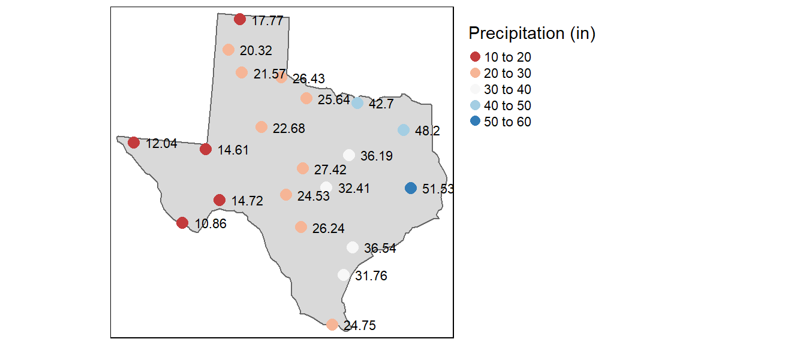
Interpolation tool: Summary & application
Distribution of meteorological stations (points) showing precipitation values
Average yearly precipitation (reported in inches) for several meteorological sites in Texas
https://mgimond.github.io/
Notes:
https://mgimond.github.io/Spatial/spatial-interpolation.html
We need to define the nature of our point dataset.
The point data represented a complete enumeration of discrete events or observations–i.e. the entity of interest only occurred as discrete locations within a study area and therefore could only be measured at those locations.
Our point data represents sampled observations of an entity that can be measured anywhere within our study area. Another class of techniques used with points that represent samples of a continuous field are interpolation methods. There are many interpolation tools available, but these tools can usually be grouped into two categories: deterministic and statistical interpolation methods.

Slide 80
Interpolation tool: Summary & application
Distribution of meteorological stations (points) showing precipitation values
how can I estimate the precipitation values where data were not observed?
Notes:
https://mgimond.github.io/Spatial/spatial-interpolation.html
We need to define the nature of our point dataset.
The point data represented a complete enumeration of discrete events or observations–i.e. the entity of interest only occurred a discrete locations within a study area and therefore could only be measured at those locations.
Our point data represents sampled observations of an entity that can be measured anywhere within our study area. Another class of techniques used with points that represent samples of a continuous field are interpolation methods. There are many interpolation tools available, but these tools can usually be grouped into two categories: deterministic and statistical interpolation methods.

Slide 81
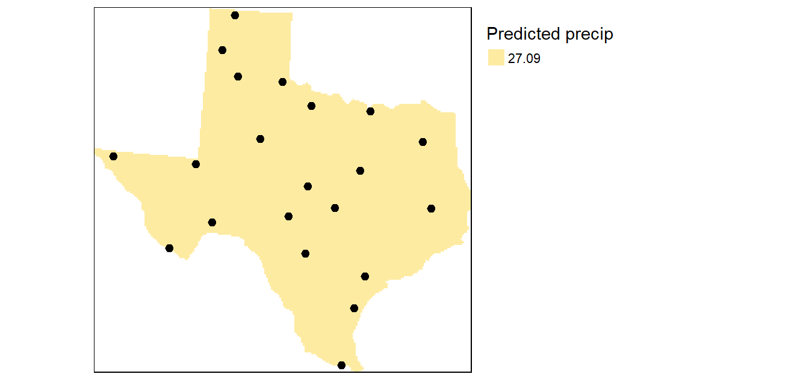
Interpolation tool: Summary & application
0th Order Trend Surface
Z = a
where a is the mean precipitation value of all sample points
The simplest model where all interpolated surface values are equal to the mean precipitation.
https://mgimond.github.io/
Notes:
The first model (and simplest model), is the 0th order model which takes on the following expression: Z = a where the intercept a is the mean precipitation value of all sample points (27.1 in our working example). This is simply a level (horizontal) surface whose cell values all equal 27.1.

Slide 82
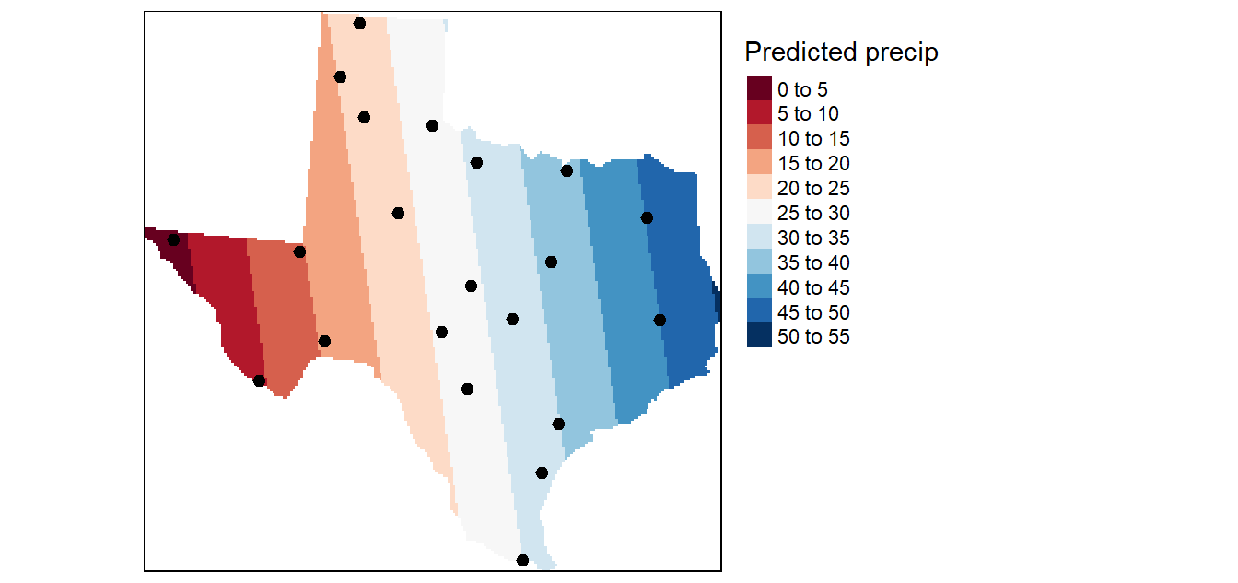
Interpolation tool: Summary & application
1st Order Trend Surface
Z = a + bX + cY
where X and Y are the coordinate pairs
Result of a first order interpolation
https://mgimond.github.io/
Notes:
The first order surface polynomial is a slanted flat plane whose formula is given by: Z = a + bX + cY where X and Y are the coordinate pairs.
The 1st order surface trend does a good job in highlighting the prominent east-west trend. But is the trend truly uniform along the X axis?
Let’s explore a more complicated surface: the quadratic polynomial.

Slide 83
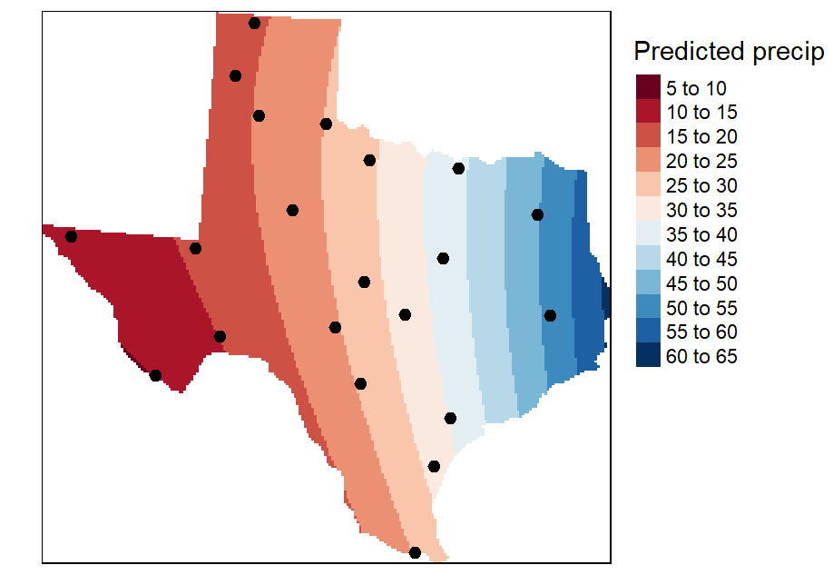
Interpolation tool: Summary & application
2nd Order Trend Surface (quadratic polynomial)
Z=a+bX+cY+dX2+eY2+fXY
Result of a second order interpolation
https://mgimond.github.io/
Notes:
The second order surface polynomial (or quadratic polynomial) is a parabolic surface whose formula is given by: Z=a+bX+cY+dX2+eY2+fXY
This interpolation picks up a slight curvature in the east-west trend. But it’s not a significant improvement over the 1st order trend

Slide 84
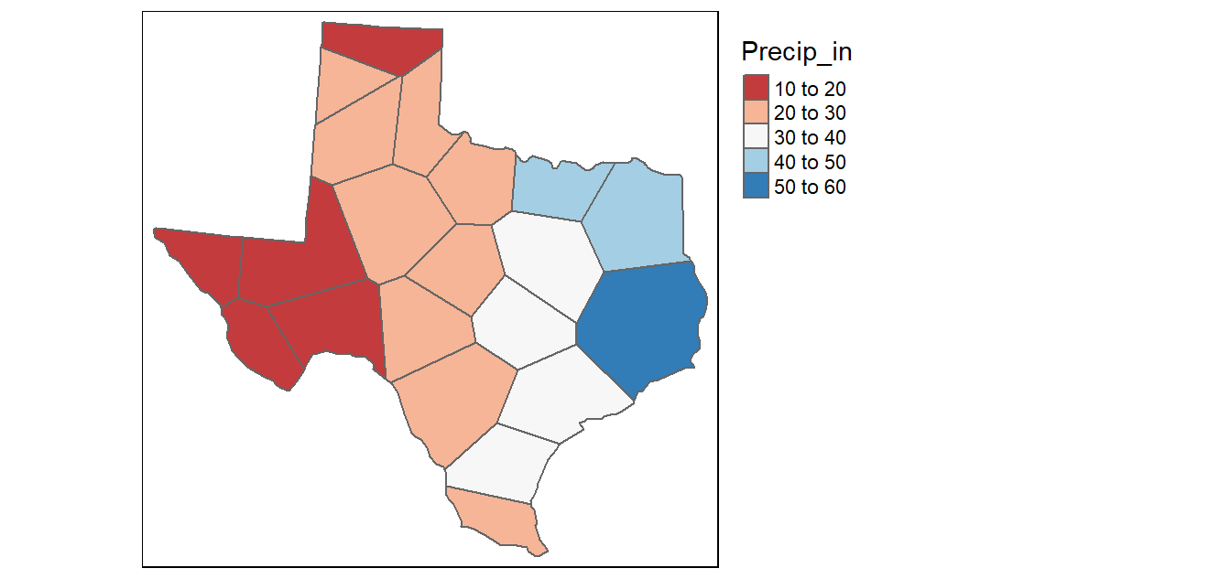
Interpolation tool: Summary & application
Thiessen interpolation
Tessellated surface generated from discrete point samples.
https://mgimond.github.io/
Notes:
We will explore two deterministic methods: proximity (aka Thiessen) techniques and inverse distance weighted techniques (IDW for short).
This is probably the simplest (and possibly one of the oldest) interpolation method. It was introduced by Alfred H. Thiessen more than a century ago. The goal is simple: Assign to all unsampled locations the value of the closest sampled location. This generates a tessellated surface whereby lines that split the midpoint between each sampled location are connected thus enclosing an area. Each area ends up enclosing a sample point whose value it inherits.
One problem with this approach is that the surface values change abruptly across the tessellated boundaries.
This is not representative of most surfaces in nature.

Slide 85


Interpolation tool: Summary & application
IDW interpolation, power of 2
An IDW interpolation of the average yearly precipitation. An IDW generated with power coefficient (n) of 2
https://mgimond.github.io/
Notes:
In the following figure, the sampled points and values are superimposed on top of an (IDW) interpolated raster generated with a n value of 2.
Note duck egg.

Slide 86

Interpolation tool: Summary & application
IDW interpolation, power of 15
An IDW power coefficient n of 15
https://mgimond.github.io/
Notes:
In the following example, an n value of 15 is used to interpolate precipitation.
This results in nearby points having greater influence on the unsampled locations. Note the similarity in output to the proximity (Thiessen) interpolation.
An IDW interpolation of the average yearly precipitation (reported in inches) for several meteorological sites in Texas.
An IDW power coefficient of 15 was used in this example.

Slide 87
Interpolation tool: Summary & application
how can I quantify the accuracy of the estimated values?
Notes:
One option is to split the points into two sets: the points used in the interpolation operation and the points used to validate the results.
While this method is easily implemented it does suffer from significant loss in power–i.e. we are using just half of the information to estimate the unsampled locations.
A better approach is to remove one data point from the dataset and interpolate its value using all other points in the dataset then repeating this process for each point in that dataset (while making sure that the interpolator parameters remain constant across each interpolation). The interpolated values are then compared with the actual values from the omitted point. This method is sometimes referred to as leave-one-out cross-validation.
The performance of the interpolator can be summarized by computing the root-mean of squared residuals (RMSE) from the errors as follows:

Slide 88
Accuracy of the estimated values
Option 1: split the points into two sets:
The points used in the interpolation operation and the points used to validate the results
Option 2: so called “leave-one-out cross validation analysis”
Remove one data point from the dataset and interpolate its value using all other points in the dataset
Repeat this process for each point in that dataset (the interpolator parameters remain constant)
The interpolated values are then compared with the actual values from the omitted point
Statistics: example root-mean of squared residuals (RMSE)
Notes:
https://mgimond.github.io/Spatial/spatial-interpolation.html
the points used in the interpolation operation and the points used to validate the results. While this method is easily implemented (even via a pen and paper adoption) it does suffer from significant loss in power–i.e. we are using just half of the information to estimate the unsampled locations.
A better approach is to remove one data point from the dataset and interpolate its value using all other points in the dataset then repeating this process for each point in that dataset (while making sure that the interpolator parameters remain constant across each interpolation). The interpolated values are then compared with the actual values from the omitted point. This method is sometimes referred to as leave-one-out cross-validation.
The performance of the interpolator can be summarized by computing the root-mean of squared residuals (RMSE) from the errors as follows:

Slide 89



Accuracy of the estimated values
Option 2: so called “leave-one-out cross validation analysis”
Where
is the interpolated value at the unsampled location i where the sample point was removed
is the true value at location i
n is the number of points in the dataset
Notes:
The performance of the interpolator can be summarized by computing the root-mean of squared residuals (RMSE) from the errors as follows:

Slide 90

Accuracy of the estimated values
Option 2: so called “leave-one-out cross validation analysis”
Scatter plot fitting predicted values vs. the observed values at each sampled location following a
leave-one-out cross validation analysis
https://mgimond.github.io/
Notes:
We can create a scatterplot of the predicted vs. expected precipitation values from our dataset. The solid diagonal line represents the one-to-one slope (i.e. if the predicted values matched the true values exactly, then the points would fall on this line). The red dashed line is a linear fit to the points which is here to help guide our eyes along the pattern generated by these points.

Slide 91

Thanks!
Feedback questions

